Slide 1
Developing a Servlet-Based E-commerce Application

Slide 2
Features
User-End:
User Authentication
Product Catalog Management
Shopping Cart Functionality
Order processing
Payment integration
Admin-End:
Managing Products
Orders
Customers Help
Login/Register
Profile Management
Search for products
Filter Products
Add to Cart/Buy Products
Add/Remove Products
Increase/Decrease Quantity
Total price display
Check Status of order
Old Order History
Add Payment Functionality for
buying products
Add / Remove Products
Changing the status of Order
Resolving the customer
Tickets

Slide 3
User Accessible Flow & Pages

Slide 4
Registration Page
New User
Re-login
Login Info Correct
Failed
User
Forgot Password
Password Update Page
Pass
Account Profile/Dashboard
Update Details
Products Page
Home Page
Order History
Add to Cart
Products Page
Proceed to Checkout
Add to Cart
Payment Details
Track Order
Proceed to Checkout

Slide 5
Database Tables
Users Table: This table stores information about registered users.
UserID (Primary Key)
Username
Email
Password (encrypted)
Address
Phone Number
Orders Table: This table keeps track of orders placed by users.
OrderID (Primary Key)
UserID (Foreign Key referencing Users.UserID)
OrderDate
TotalAmount
OrderStatus (e.g., Pending, Shipped, Delivered)
ShippingAddress
BillingAddress
OrderItems Table: This table stores the individual items within each order.
OrderItemID (Primary Key)
OrderID (Foreign Key referencing Orders.OrderID)
ProductID (Foreign Key referencing Products.ProductID)
Quantity
Price
Subtotal
Payment Table: This table records payment information for orders.
PaymentID (Primary Key)
OrderID (Foreign Key referencing Orders.OrderID)
PaymentMethod
PaymentDate
Amount
PaymentStatus
Ticket Table: This table will stores the issues raised by user.
1. UserID (foreign Key referencing Users.UserID)
2. Email
3. Issue_msg

Slide 6
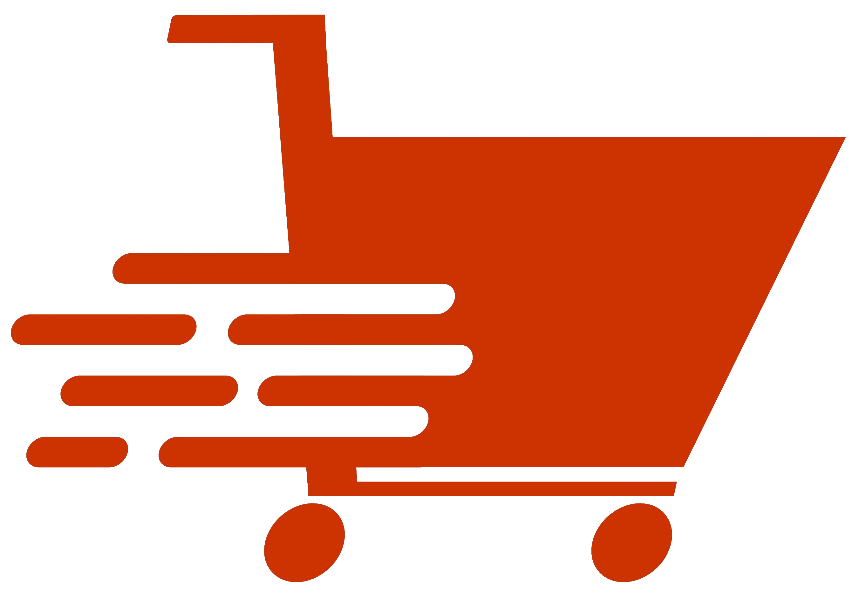


Home Bicycles Acessories About Contact
Login now
Email
Enter your email
Password
Enter your password
Forgot password?
hover
Login
Login
New User?
Register Now
Admin Login? Click Here
FOOTER

Slide 8
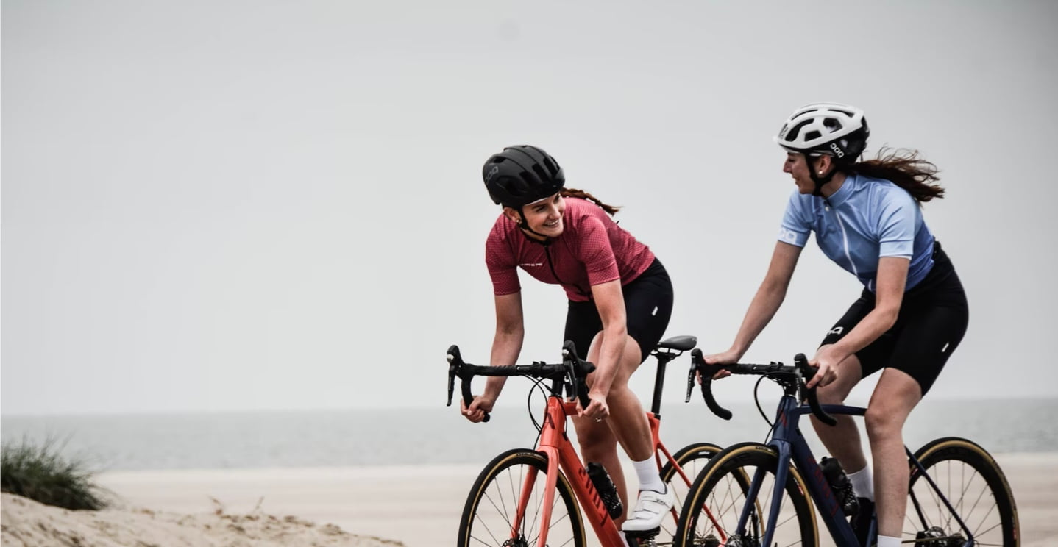
User Authentication: Registration Page
Home Bicycles Acessories About Contact
New User?
Register Now
Name
Email
Password
Confirm password
Register
Existing User?
Login Now
FOOTER SECTION

Slide 10

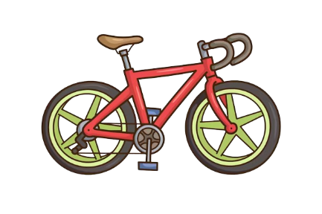
Forgot Password Page
Home Bicycles Acessories About Contact
Forgot Password?
Email
New Password
Confirm password
Change Password
Footer Section

Slide 12
Add to Cart Page
My Cart
Products Quantity Price
1
$ 100.00
< >
Product Name
1
$ 100.00
< >
Product Name
Total $200.00
Proceed to Checkout
Footer Section

Slide 13
Procced to Checkout Page
1. Shipping Details
Name
Address Line 1
Address Line 2
Pin Code
Contact Number
Contact Number
Payment Details
Cash on Delivery
Net Banking
Cards
Total Price: $200.00
Buy Now
Footer Section

Slide 14

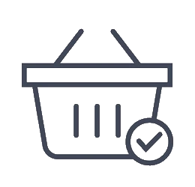
Ordered Successful Page
Your Order Successfully Placed
Track Order >
Footer Section

Slide 15
User Details Page
User Details
Name
Email
Contact Number
Address Line 1
Address Line 2
Pin Code
Update
My Orders
Products Quantity Price Status
1
$ 100.00
Out for Delivery
< >
Product Name
1
$ 100.00
Delivered
< >
Product Name
Update Password
Old Password
New Password
Confirm New
Password
Update Password
(Additional) Raise Ticket
Name
Email
Detailed Issue
Description in detail
Raise Ticket
Footer Section

Slide 16
Admin Accessible Flow & Pages

Slide 17
Orders
Update Order Status
Login
Passed
Admin
Dashboard
Products
Add, Update, Delete Cycles/ Accessories
Users
View User details

Slide 18
Database Table: Admin
Admins Table: This table stores information about admin users.
AdminID (Primary Key)
Username
Email
Password (encrypted)
Products Table: This table contains information about the products available for sale.
ProductID (Primary Key)
Name
Description
Price
StockQuantity
CategoryID (Foreign Key referencing Categories.CategoryID)
Categories Table: This table holds information about product categories.
CategoryID (Primary Key)
Name
Description
ParentCategoryID (for hierarchical categories, references self)
Images Table: This table stores images associated with products.
ImageID (Primary Key)
ProductID (Foreign Key referencing Products.ProductID)
ImageURL
Ticket Table: This table will stores the issues raised by user.
1. UserID (foreign Key referencing Users.UserID)
2. Email
3. Issue_msg

Slide 19

Admin Login
Home Bicycles Acessories About Contact
Admin Login
Email
Enter your email
Password
Enter your password
hover
Login
Login
FOOTER

Slide 20
Logo Samples

Slide 21





Search For Products
Login
Register
Mega
mart

Slide 22

MegaMart
MegaMart

Slide 23

ega
art

Slide 24

ShopNest
ShopNest

Slide 25
S
ShopNest

Slide 26
